Slide 1


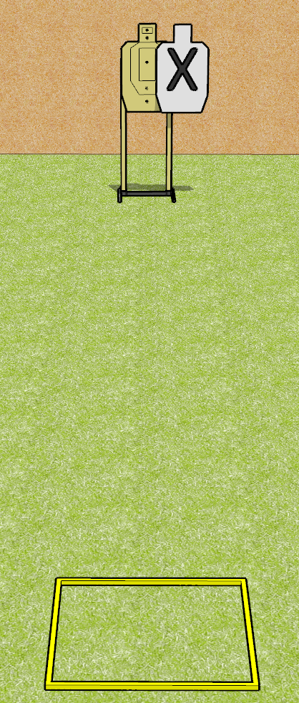
 | Dothan Gun Club – USPSA Match Weak Hand Bill Drill Course Designer : Drew Coleman
Round Count 12 rounds 1 USPSA target
Equipment List Shoot box

Slide 2
Weak Hand Bill Drill
Written Stage Briefing
Weak Hand Bill Drill is a 12 round, 60 point, Comstock speed shoot. There is 1 USPSA target, and the best 12 hits will score. The start signal is audible.
Handgun start position is in shooting box, wrists below belt. Handgun is loaded and holstered.
PCC start position is in shooting box, stock on belt. Loaded carbine is held with both hands safety on.
On start signal, engage target with 6 rounds, perform a mandatory reload, and then engage with 6 rounds weak hand only.

Slide 3
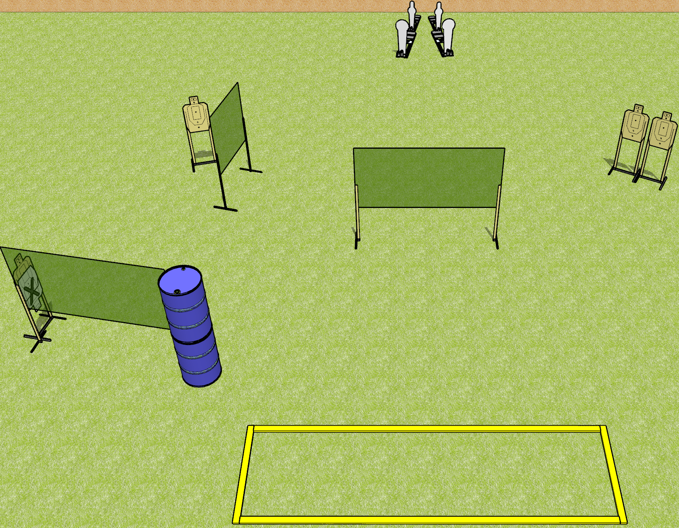
 | Dothan Gun Club – USPSA Match Keep it Short Course Designer : Drew Coleman
Round Count 12 rounds 4 USPSA 2 colt poppers, 2 mini poppers
Equipment List 6 wall feet 4 8’ fault lines, 2 medium fault lines

Slide 4
Keep it Short
Written Stage Briefing
Keep it Short is a 12 round, 60 point, Comstock course of fire. There are 4 USPSA targets, 2 colt poppers, and 2 mini poppers. The best 2 hits on paper will score, and steel must fall to score. The start signal is audible.
Handgun start position is completely outside the shooting area, wrists above shoulders. Handgun is UNLOADED and holstered.
PCC start position is completely outside the shooting area, stock on belt. Carbine is UNLOADED.
On start signal, engage targets as they become available from within the shooting area.

Slide 5
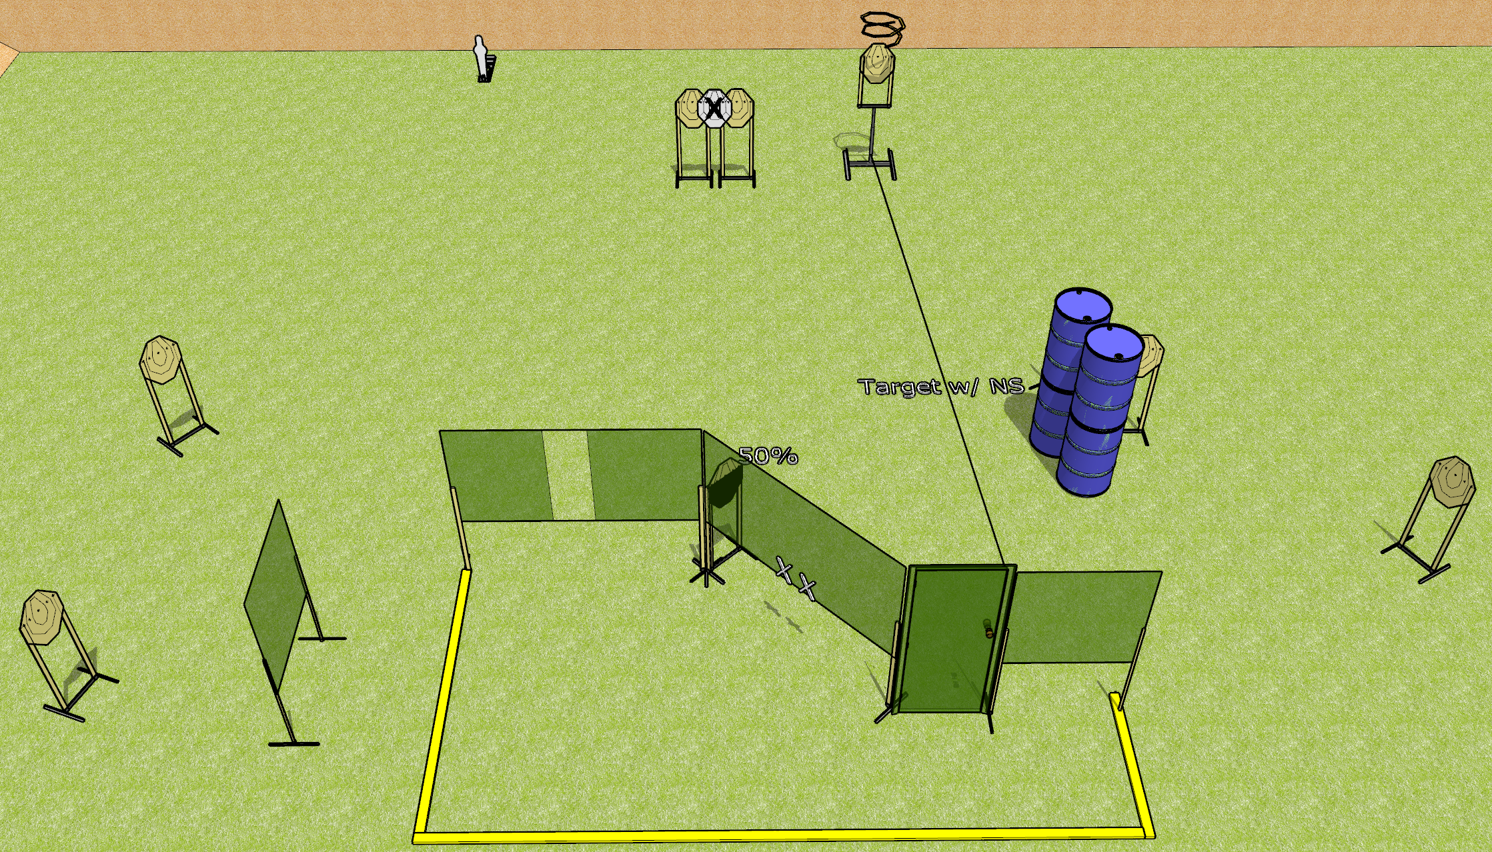
 | Dothan Gun Club – USPSA Match Open and Drop Course Designer : Drew Coleman
Round Count 19 rounds 9 IPSC 1 mini popper
Equipment List 1 medium fault line (use 10’ for far left) 1 50% Drop turner + activator + door

Slide 6
Open and Drop
Written Stage Briefing
Open and Drop is a 19 round, 95 point, Comstock course of fire. There are 9 IPSC targets and 1 mini popper. The best 2 hits on paper will score, and steel must fall to score. The start signal is audible.
The drop turner is activated by the door and is a disappearing target.
Handgun start position is hands on marks, handgun loaded and holstered.
PCC start position is muzzle on either mark, stock on belt. Loaded carbine is held with both hands, safety on.
On start signal, engage targets as they become available from within the shooting area.

Slide 7
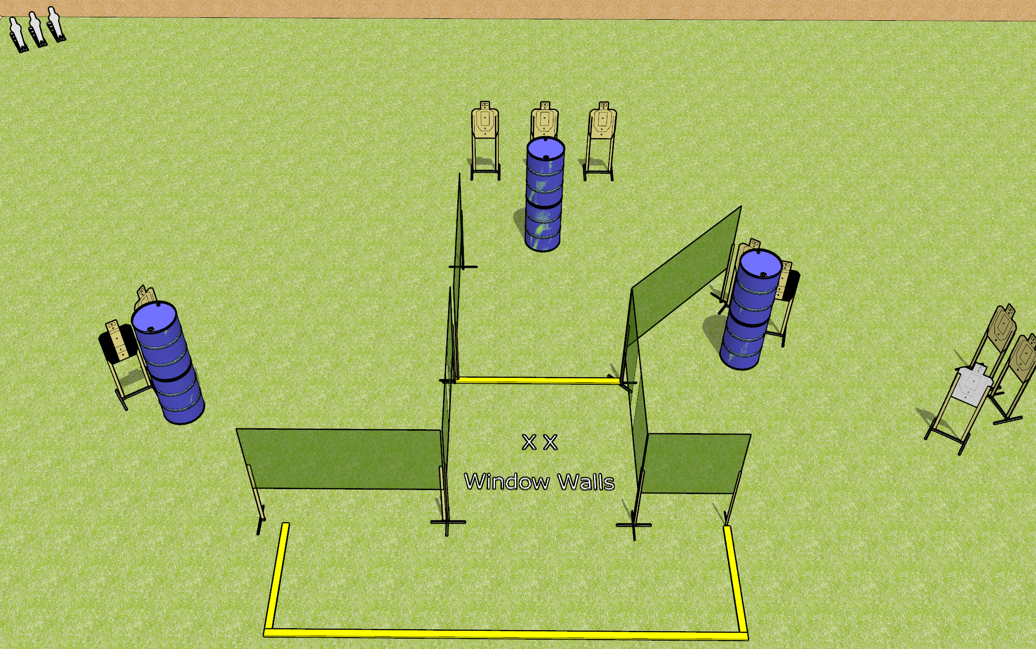
 | Dothan Gun Club – USPSA Match Windows Course Designer : Drew Coleman
Round Count 21 rounds 9 USPSA 3 mini poppers
Equipment List 9 wall feet 2 medium fault lines 2 tuxedos

Slide 8
Windows
Written Stage Briefing
Windows is a 21 round, 105 point, Comstock course of fire. There are 9 USPSA targets and 3 mini poppers. The best 2 hits on paper will score, and steel must fall to score. The start signal is audible
Handgun start position is both feet on X’s, wrists below belt. Handgun is loaded and holstered.
PCC start position is both feet on X’s, stock on belt. Loaded carbine is held with both hands, safety on.
On start signal, engage targets as they become available from within the shooting area.

Slide 9
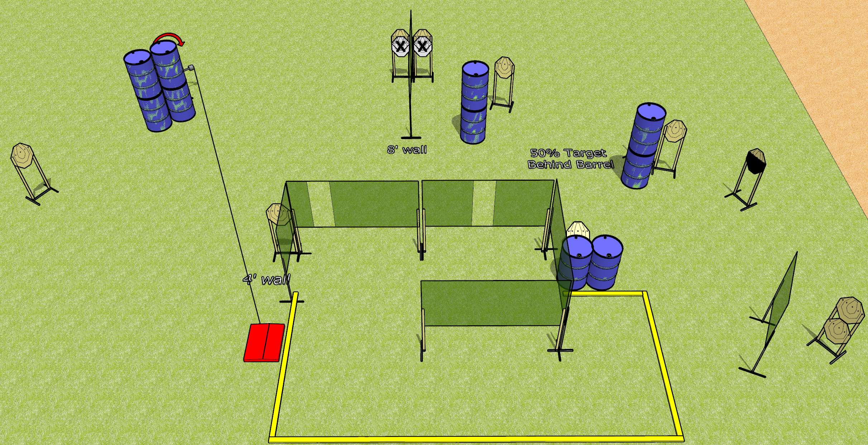
 | Dothan Gun Club – USPSA Match Hook Course Designer : Drew Coleman
Round Count 24 rounds 12 paper
Equipment List 10 wall feet 1 medium fault line Stomp box + swinger

Slide 10
Hook
Written Stage Briefing
Hook is a 24 round, 120 point, Comstock course of fire. There are 12 IPSC targets. The best 2 hits on paper will score. The start signal is audible.
The swinger is activated by the stomp box, and remains visible at rest.
Handgun start position is inside the shooting area, wrists below belt. Handgun is loaded and holstered.
PCC start position is inside the shooting area, stock on belt. Loaded carbine is held with both hands, safety on.
On start signal, engage targets as they become available from within the shooting area.

Slide 11
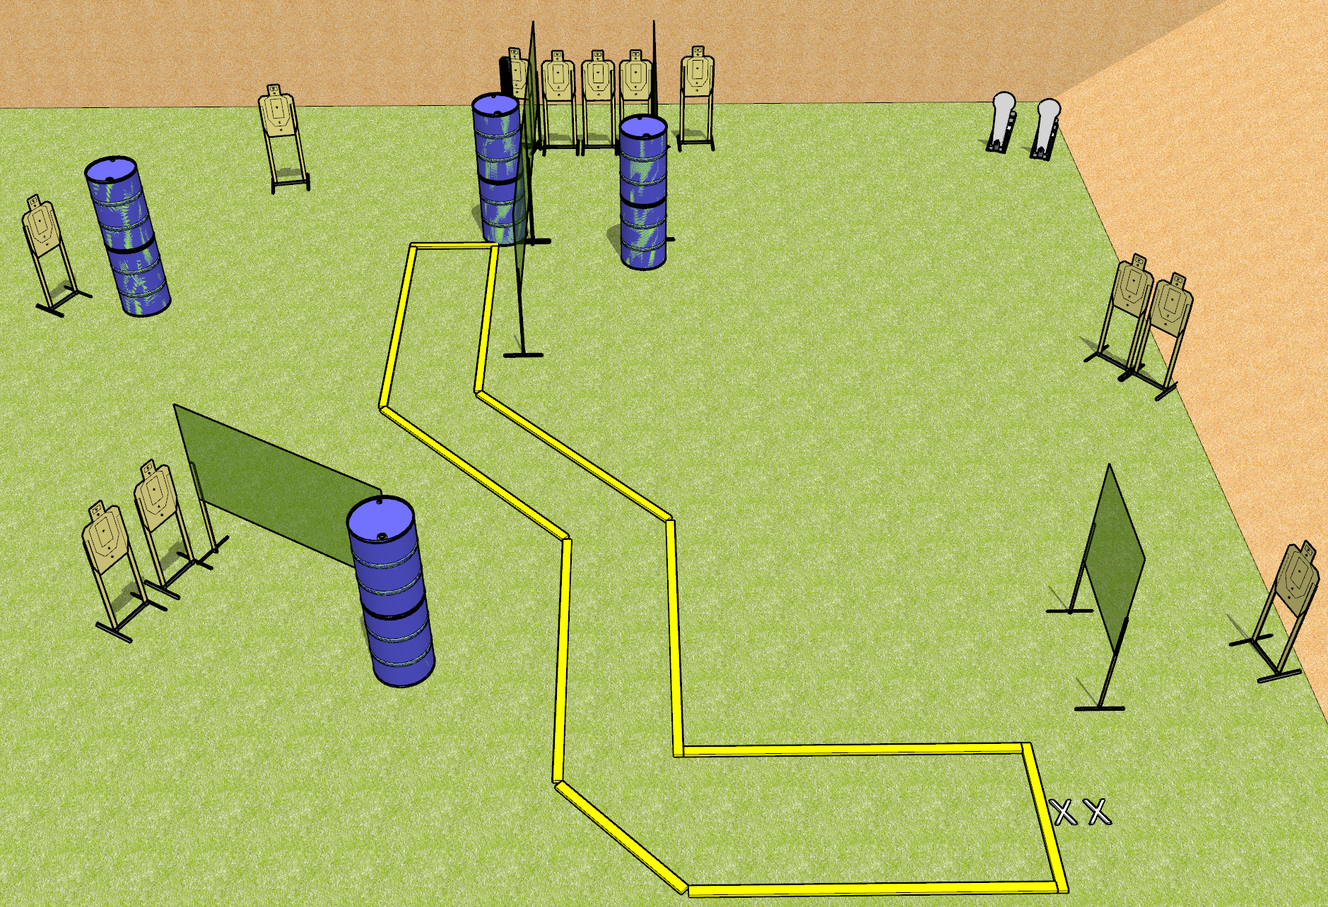
 | Dothan Gun Club – USPSA Match Check Your Corners Course Designer : Drew Coleman
Round Count 26 rounds 12 USPSA 2 Colt poppers
Equipment List 3 medium fault lines 9 wall feet 8 10’ fault lines

Slide 12
Check Your Corners
Written Stage Briefing
Check Your Corners is a 26 round, 130 point, Comstock course of fire. There are 12 USPSA targets and 2 colt poppers. The best 2 hits on paper will score, and steel must fall to score. The start signal is audible.
Handgun start position is toes on X’s, wrists below belt. Handgun is loaded and holstered.
PCC start position is toes on X’s, stock on belt. Loaded carbine is held with both hands, safety on.
On start signal, engage targets as they become available from within the shooting area.

Slide 13
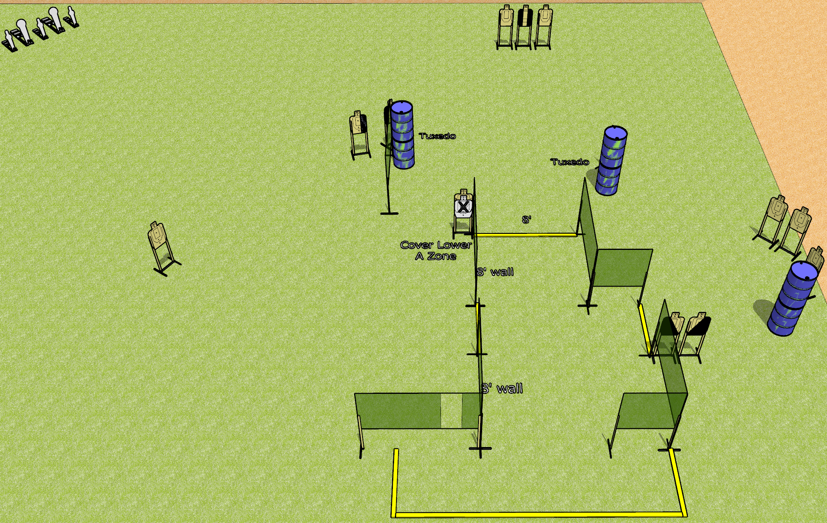
 | Dothan Gun Club – USPSA Match Silly String Course Designer : Drew Coleman
Round Count 31 rounds 13 USPSA 3 mini poppers, 2 colt poppers
Equipment List 13 wall feet 4 medium fault lines 3 tuxedos, 2 diagonal

Slide 14
Silly String
Written Stage Briefing
Silly String is a 31 round, 155 point, Comstock course of fire. There are 13 USPSA targets, 3 mini poppers, and 2 colt poppers. The best 2 hits on paper will score, and steel must fall to score. The start signal is audible.
Handgun start position is anywhere outside the shooting area, wrists below belt. Handgun is loaded and holstered.
PCC start position is anywhere outside the shooting area, stock on belt. Loaded carbine is held with both hands, safety on.
On start signal, engage targets as they become available from within the shooting area.

Slide 15
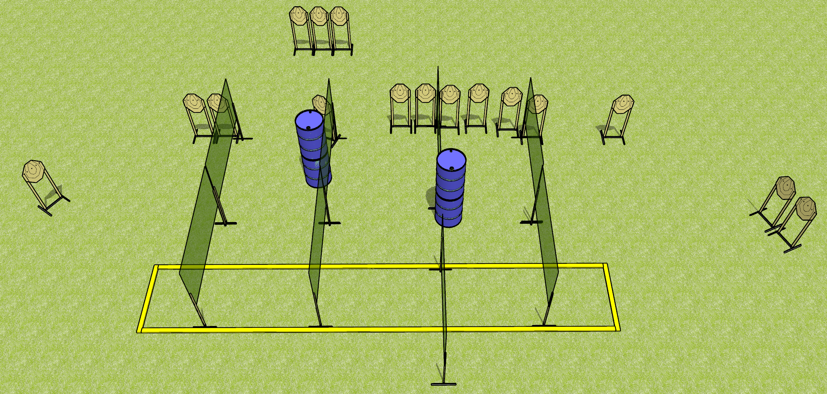
 | Dothan Gun Club – USPSA Match Turtle Massacre Course Designer : Drew Coleman
Round Count 32 rounds 16 IPSC
Equipment List 13 wall feet 2 medium fault lines Make shooting area 30 feet wide

Slide 16
Turtle Massacre
Written Stage Briefing
Turtle Massacre is a 32 round, 160 point, Comstock course of fire. There are 16 IPSC targets. The best 2 hits on paper will score. The start signal is audible.
Handgun start position is anywhere outside the shooting area, wrists below belt. Handgun is loaded and holstered.
PCC start position is anywhere outside the shooting area, stock on belt. Loaded carbine is held with both hands, safety on.
On start signal, engage targets as they become available from within the shooting area.

